Slide 1

ANNAMACHARYA INSTITUTE OF TECHNOLOGY AND SCIENCES::TIRUPATI (AUTONOMOUS) Venkatapuram(v),Karkambadi(p),Renigunta(m),Tirupati-517520,A.P COMPUTER SCIENCE AND ENGINEERING SOCIAL RELEVANT PROJECT
CAMPUS RECRUITMENT SYSTEM
BY
TEAM MEMBERS (BATCH NO-25)
R.Meghana -19AK1A05A1
Y.Kalavathi -19AK1A0574
V.Nikhil Sai Teja -19AK1A05B2
Y.Pavan Kalyan -20AK5A0506
D.S.S.S.S.Jaya Kumar -19AK1A0571
Under the guidance of Head of the department
Mr.M. Kiran Moni Mr.B.Ramana Reddy

Slide 2

TABLE OF CONTENTS
Introduction
Analysis
Design
Implementation
Testing
Data flow diagram
E-R diagram
Features
Advantages and Disadvantages
Modules
Output screens
Conclusion & Future enhancement

Slide 3
introduction
Biggest concerns of students in their final year of college is getting a job offer in a campus placement drive.
This project is beneficial for college students, various companies visiting the campus for recruitment and even the college placement officers of companies like Accenture, TCS, Infosys, Cognizant, etc.,
The admin checks each student details and removes faulty accounts. The system also consists of a company login where various companies visiting the college can view a list of students in that college and also their respective resumes.
The software system allows students to view a list of companies who have posted for vacancy. The admin has overall rights over the system and can moderate and delete any details not pertaining to college placement rules.
This system handles student as well as company data and efficiently displays all this data to respective sides.

Slide 4
Analysis
The college campus recruitment system provides options like company login and admin login. This software system provides an option to the admin to create the profiles of students who joined in the campus recruitment training and also upload their details including their marks onto the system. The system also consists of a company login, where various companies visit the college can view the list of students in that college and their respective resumes. The admin has overall rights over the system and can moderate and delete any details not pretraining to college placement rules. The project is beneficial for college students, various companies visiting the campus for recruitment and even the college placement officer. The admin handles student as well as company data and efficiently.

Slide 5
design
INTRODUCTION TO SYSTEM DESIGN
The design phase is the life cycle phase in which the detailed design of the selected system in the study phase is accomplished. In the design phase, the technical specifications are prepared for the performance of allocated tasks. It also includes the construction of programs and program testing. In the design phase, the first step is to determine the output is to produced and in what format. Second, input data and master files have to be designed to meet the requirements of proposed output. The system analyst has to define the methods of capturing and input programs and format of the outputs and its use by the users. The design is a solution, the translation of requirements into center ways of meeting. The design is actually, the process of analyzing, and developing a database model that accurately reflects the organizing functioning in the real world and implementing that model by creating a database requires an appropriate methodology.

Slide 6
Implementation
Filling of forms by students A form is given to students in which they have to fill with all details such as name, roll number, contact details, percentages (all semester), other details like name of institution, place, year of pass, percentage, SSC details (name of institution, place, year of pass, percentage).
Filling of forms by Company's A form is given to Company in which they have to fill with all details such as company name, CEO, COO, location etc
Creating Vacancies and verifying applied candidates by Companies in Company Dashboard
Checking all the Data of Companies and Students who are Registered, Placed and etc.,

Slide 7
testing
After the system is built, the unit testing, system testing and user acceptance testing are needed for errors detection before the system is distributed. This is to ensure the performance of the system is in its optimal state. Besides, the errors and bugs that are detected during testing of the proposed system can be fixed. The unit and system testing will be tested by developer while the user acceptance testing will be tested by a few end-users to ensure the functionalities of system are working as expected.

Slide 8
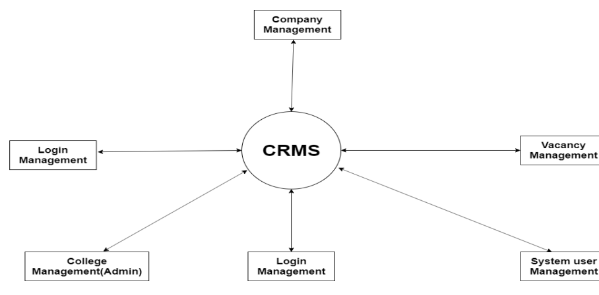
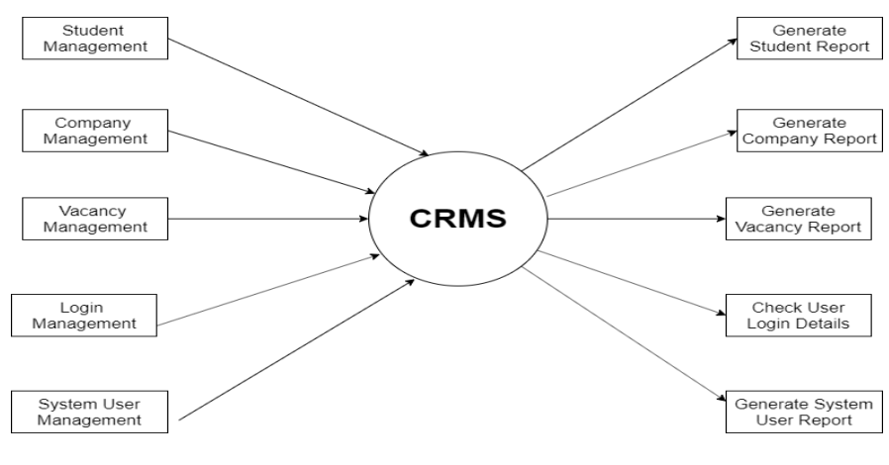
DATA FLOW DIAGRAM(DFD)
Zero level DFD
First level DFD

Slide 9
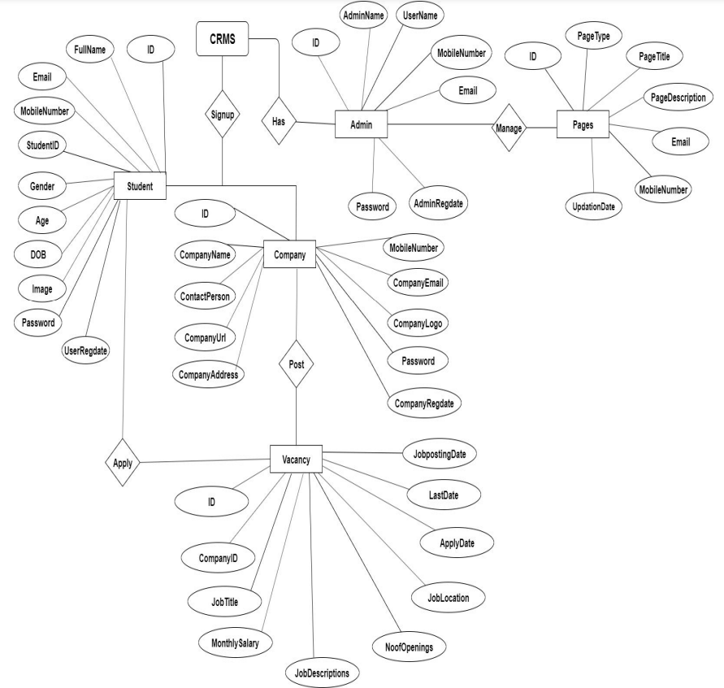
E-R DIAGRAM

Slide 10
features
LOAD BALANCING: Since the system will be available for admin, student, company logs in the amount of load on server will be for all users and can access.
EASY ACCESSIBILITY: Records can be easily accessed and stored and other information respectively.
USER FRIENDLY: The website will be giving a very user friendly approach for all users.
EFFICIENT AND RELIABLE: Maintaining the all secured and database on the server which will be accessible according the user requirement without any maintenance cost will be very efficient as compared to storing the users data on the spreadsheet or in physically in the record books.
EASY MAINTENANCE: Automated college campus recruitment system website is design as easy way. So maintenance is also easy.

Slide 11
ADVANTAGES AND DISADVANTAGES:
ADVANTAGES:
There will be no need of putting up notice or emailing every student about the company coming in college. the student can keep updated themselves through this software.
There is admin login that can view and manage both student and company’s account and also can put up notifications.
The company can view all students details and system can shortlist students according to their criteria instead of doing manually.
Students can register online instead of going to placement department for registration.
This system saves the time and efforts.
DISADVANTAGES:
Without database it won’t work properly.
Student cannot edit their application once sent. It would require admin to change the data.

Slide 12
modules
campus recruitment system is a web based application which guides you about campus recruitment process. This project includes mainly 3 main modules
LOGIN: 1.Admin 2.Student 3.Company
Sub modules of Admin :
Add students, add company.
Sub modules of company:
Create vacancy

Slide 13
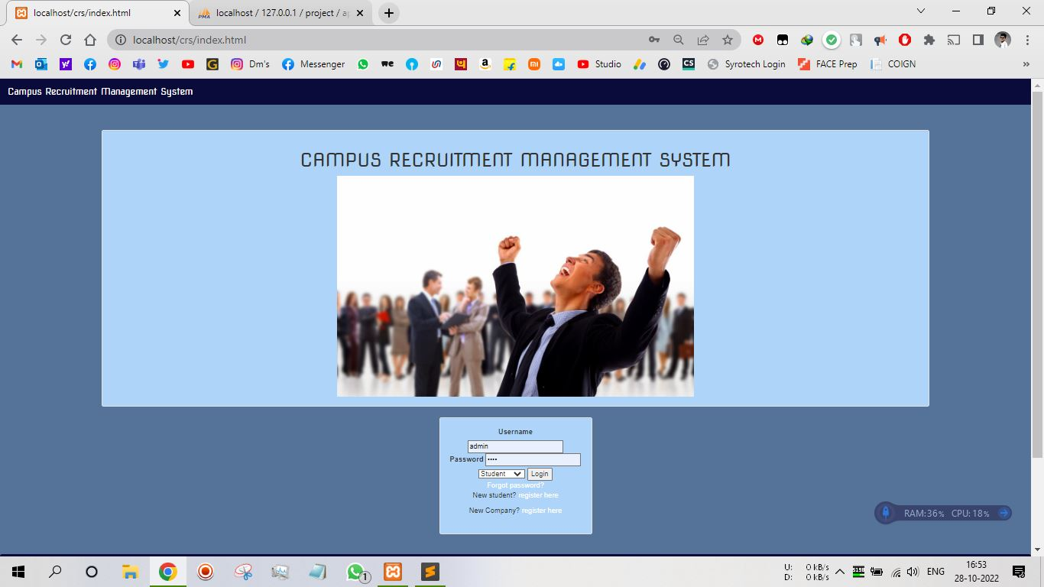
OUTPUT SCREENS

Slide 14
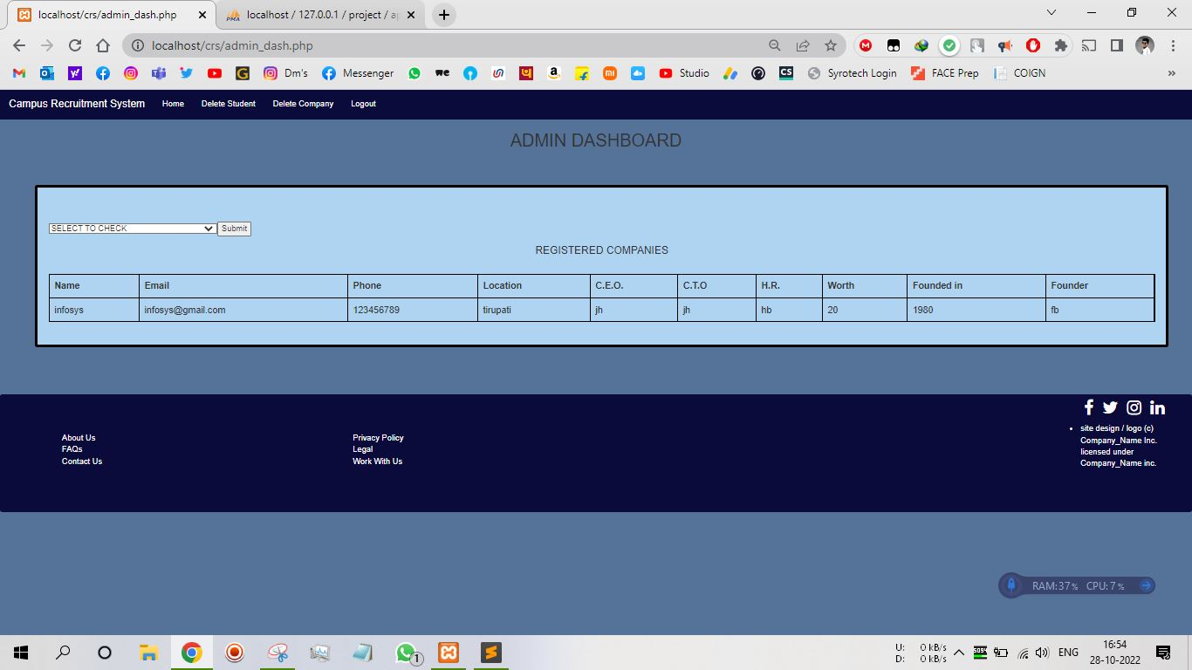
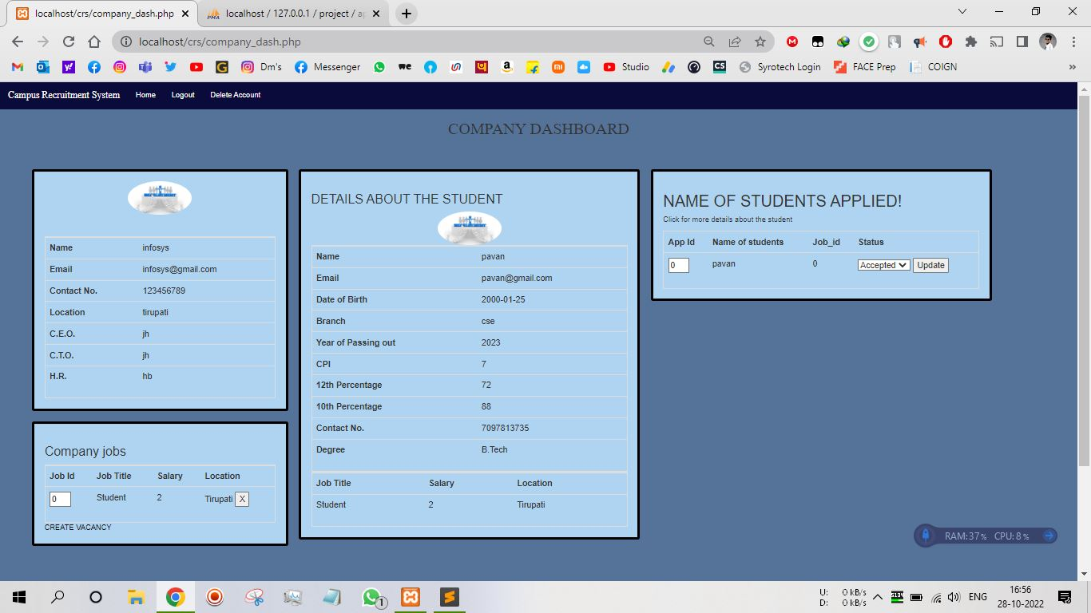
ADMIN
COMPANY

Slide 15
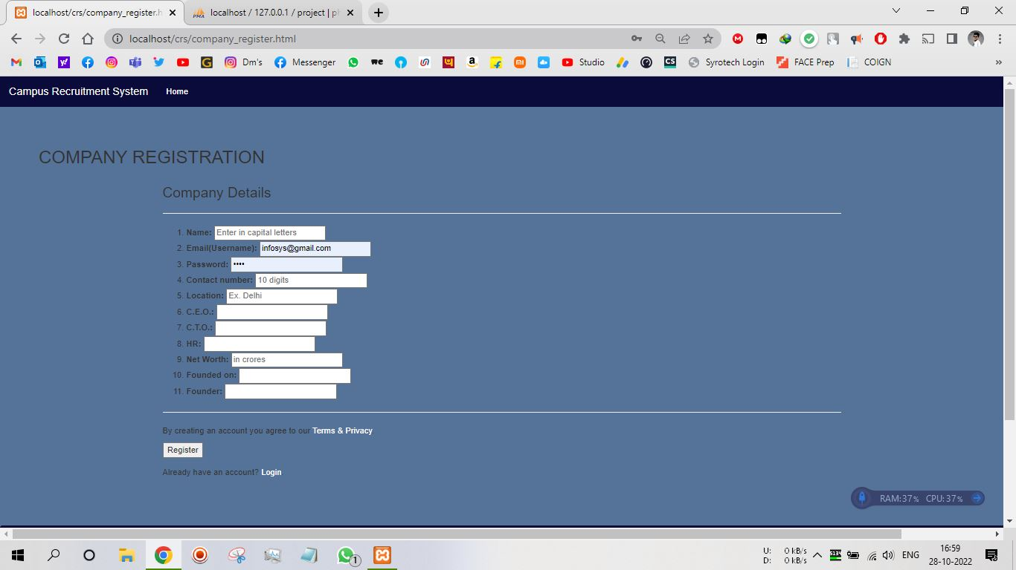
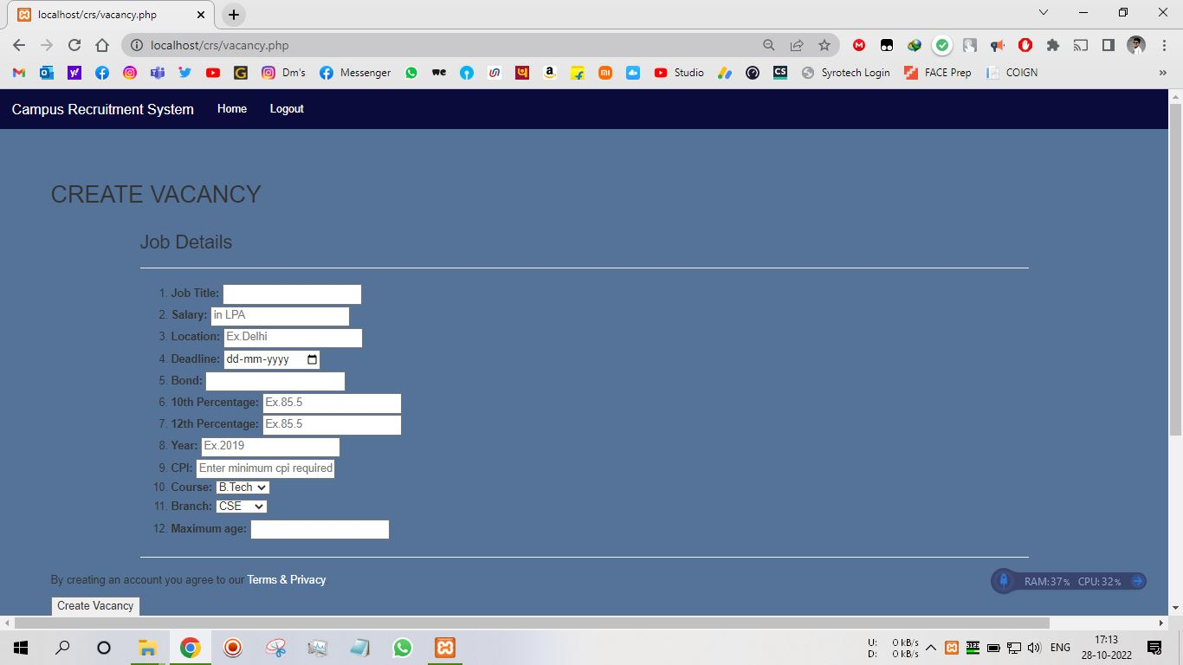
MODULES
COMPANY REGISTRATION
CREATE VACANCY

Slide 16
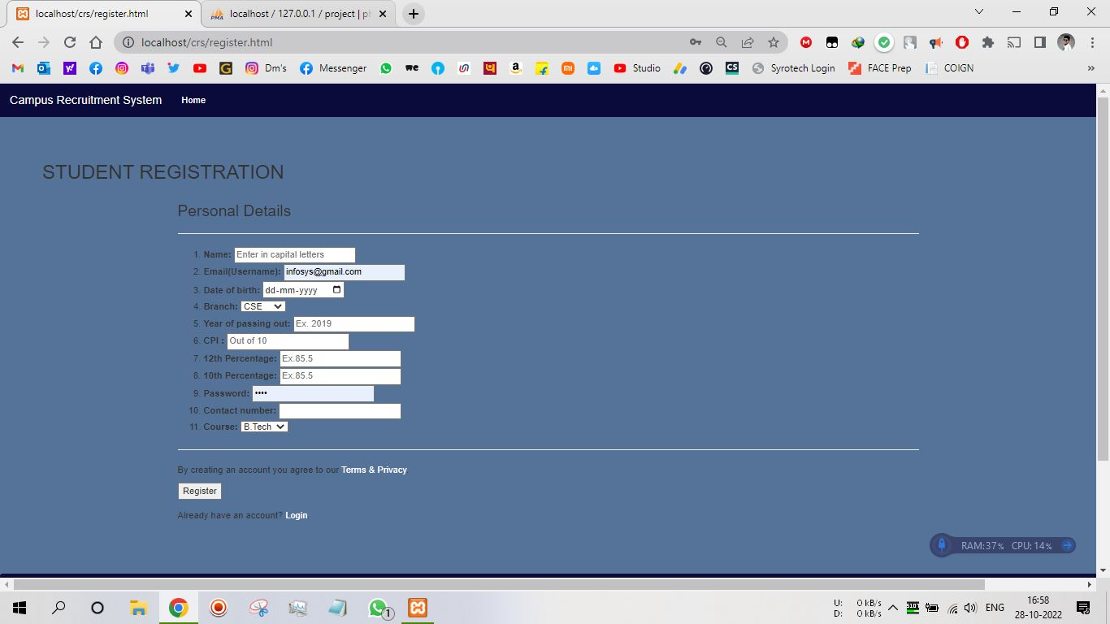
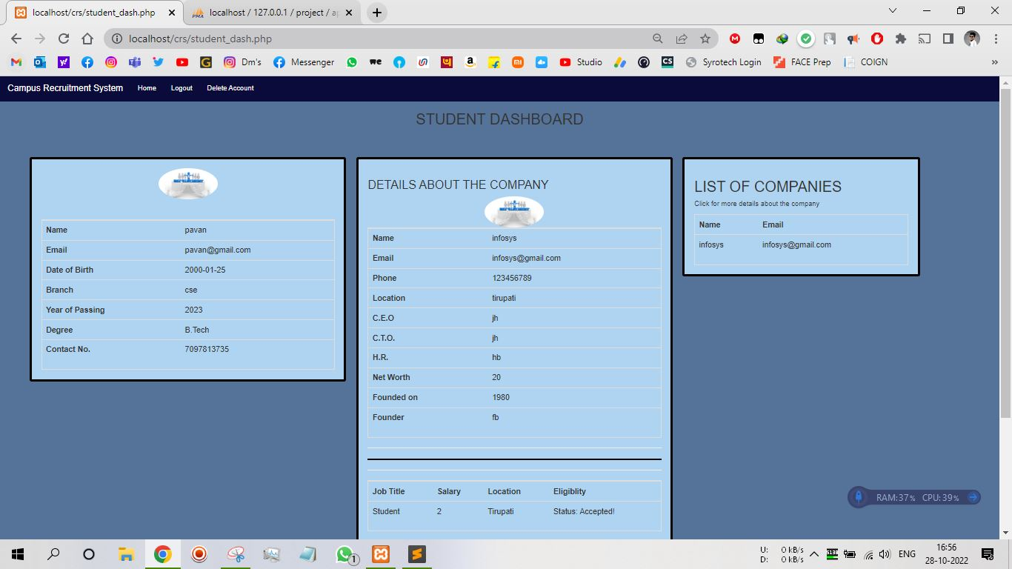
STUDENT LOGIN
STUDENT REGISTRATION
STUDENT DASHBOARD

Slide 17
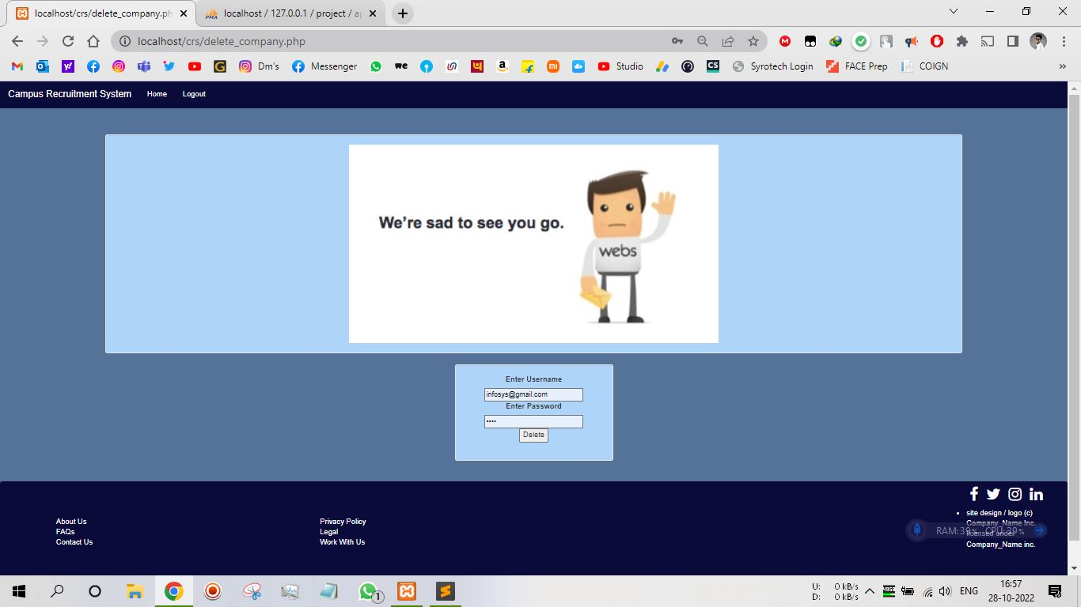
COMPANY & ADMIN LOGIN
COMPANY DASHBOARD
DELETING ACCOUNT BY ADMIN

Slide 18
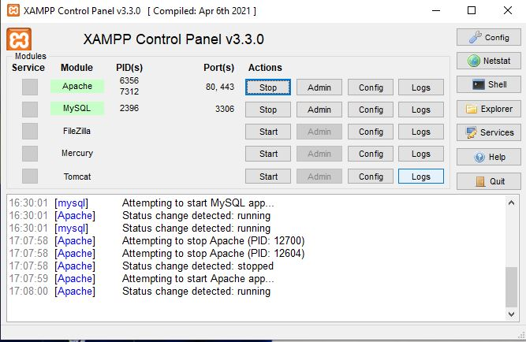
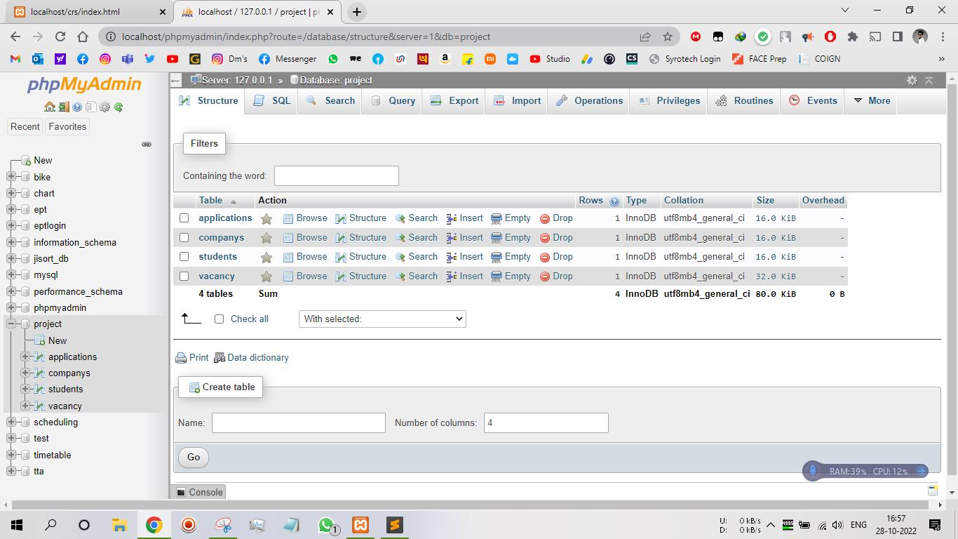
DATABASE
XAMPP CONTROL PANEL
DATABASE

Slide 19
CONCLUSION & Future enhancement
The project titled as Campus Recruitment System was deeply studied and analyzed to design the code and implement. It was done under the guidance of the experienced project guide. All the current requirements and possibilities have been taken care during the project time.
Campus Recruitment System is a platform that provide interface between students and company. System provides the list of suitable companies to the students, according to their educational qualification, experience and their preferences.
project has a very vast scope in future. Project can be updated in near future as and when requirement for the same arises, as it is very flexible in terms of expansion. With the proposed software of database CRS is ready and fully functional the client is now able to manage and hence run the entire work in a much better, accurate and error free manner.
The following are the future scope for the project.
1. Discontinue of particular student after getting placed.
2. Bar code Reader based placement system.
3. Individual qualification detail with photograph.

Slide 20


